Slide 1
Client-Side Handlers
Service-Oriented Software Engineering
Software Institute
Nanjing University
Bei Jia

Slide 2
SOAP Message Handlers
The JAX-WS handler framework allows you to define message handlers that can process XML messages before and after a Web service invocation—either on the client side or on the server side
Such handlers are commonly used to implement messaging functionality that is not specific to a particular Web service.
  For example, you might use a handler to add a wsse:Security header or a wsrm:Sequence header to a SOAP message. So that multiple standards can be supported, such as WS-Security and WS-ReliableMessaging
Using JAX-WS, there are two approaches for configuring a message handler on a client: It can be done programmatically, or with the @javax.jws.HandlerChain annotation

Slide 3
Programmatically Adding Handlers for a Web Service Invocation Client.java (1/4)
…
private static void runPersistenceHandlerTest(File persistenceDir)
throws Exception {
RequestOrderService service = new RequestOrderService();
// add the handler to the service
service.setHandlerResolver(new RequestOrderHandlerResolver());
RequestOrderPort port = service.getRequestOrderPort();
// configure message request context
Map<String, Object> reqCtxt = ((BindingProvider)port).getRequestContext();
reqCtxt.put(PersistMessageHandler.PERSISTENCE_DIR_PROP, persistenceDir);
reqCtxt.put(AddMessageIdHandler.MSGID_PROP, "msg0001");
// add the callback handler
RequestOrderCallbackHandler cbh = new RequestOrderCallbackHandler();
cbh.setStartTime((new Date()).getTime());
Future<?> response = port.requestOrderAsync(
"ENT0072123", "", createCreditCard(), createItemList(), cbh);
response.get(2000, TimeUnit.MILLISECONDS);
}
…

Slide 4
Programmatically Adding Handlers for a Web Service Invocation Client.java (2/4)
…
private static class RequestOrderHandlerResolver implements HandlerResolver {
public List<Handler> getHandlerChain(PortInfo arg0) {
List<Handler> handlerChain = new ArrayList<Handler>();
handlerChain.add(new AddMessageIdHandler());
handlerChain.add(new PersistMessageHandler());
return handlerChain;
}
}
…

Slide 5
Programmatically Adding Handlers for a Web Service Invocation Client.java (3/4)
Handlers are set up by configuring an instance of javax.xml.ws.handler.HandlerResolver on a Service instance
In this manner, any SEI proxy or Dispatch<T> created from such a Service instance will use the specified HandlerResolver to determine the handler chain defined for the particular wsdl:portType it implements.
Request context can be configured, which can be accessed by handlers
RequestOrderHandlerResolver implements HandlerResolver, This interface implements a single method— getHandlerChain(PortInfo p) —that returns a list of handlers.
At runtime, the BindingProvider (i.e., proxy or Dispatch<T>) uses this interface to get a list of handlers
Outbound messages are processed by the handlers in the order in which they appear in this list
Inbound messages (i.e., SOAP responses on the client side) are processed by the handlers in the reverse order

Slide 6
Programmatically Adding Handlers for a Web Service Invocation Client.java (4/4)
The List<Handler> returned by RequestOrderHandlerResolver contains two handlers: AddMessageIdHandler and PersistMessageHandler
Both handlers implement the javax.xml.ws.handler.soap.SOAPHandler<T extends SOAPMessageContext> interface. Therefore, these are Protocol Handlers, which operate on protocol-specific messages (and message contexts)
JAX-WS also defines Logical Handlers that operate only on the generic message payloads (and contexts). Logical Handlers implement javax.xml.ws.handler.LogicalHandler and are not able to manipulate protocol-specific parts of a message such as a SOAP header block

Slide 7
Handlers PersistMessageHandler.java (1/3)
…
public class PersistMessageHandler implements SOAPHandler<SOAPMessageContext> {
public static final String PERSISTENCE_DIR_PROP =
"samples.persistence.directory";
public Set<QName> getHeaders() {
return null;
}
public boolean handleMessage(SOAPMessageContext ctxt) {
System.out.println("Entered PersistMessageHandler.handleMessage");
// return if inbound message
if ( !((Boolean)ctxt.get(MessageContext.MESSAGE_OUTBOUND_PROPERTY)).
booleanValue()) { return true; }
SOAPMessage msg = ctxt.getMessage();
File persistenceDir = (File) ctxt.get(PERSISTENCE_DIR_PROP);
Iterator itr;
try {
itr = msg.getSOAPHeader().examineAllHeaderElements();
String msgId = null;
…

Slide 8
Handlers PersistMessageHandler.java (2/3)
…
while (itr.hasNext() && msgId == null) {
SOAPHeaderElement headerElt = (SOAPHeaderElement) itr.next();
QName headerQName = headerElt.getElementQName();
if (headerQName.equals(AddMessageIdHandler.MSGID_HEADER)) {
msgId = headerElt.getAttribute("id");
}
}
if ( msgId == null ) {
System.out.println("No message ID header.");
return false;
}
File msgFile = new File(persistenceDir, msgId+".xml");
msgFile.createNewFile();
msg.writeTo(new FileOutputStream(msgFile));
} catch (Exception e) {
e.printStackTrace();
return false;
}
return true;
}
…

Slide 9
Handlers PersistMessageHandler.java (3/3)
The handleMessage() method receives an instance of the SOAPMessageContext
The first thing that happens inside the handleMessage() method is that the context is examined to determine the value of MessageContext.MESSAGE_OUTPUT_PROPERTY to determining the direction of the message
Assuming the message is outgoing, the next thing that happens is that the handler examines the PERSISTENCE_DIR_PROP to determine the directory into which the outgoing message should be saved
Next comes the SOAP header processing to find the header where the message’s unique ID is contained. Such header processing is typical for a SOAP
If there were an authentication handler, for example, you might see code here that looked for a header containing an encrypted password to authenticate the user before sending his message over the wire
Having found the message ID, you can see that this code simply saves the message to a file using the SOAPMessage.writeTo() method
SOAPMessage and SOAPHeader are part of the SAAJ 1.3 API (SOAP with Attachments API for Java) for manipulating SOAP messages

Slide 10
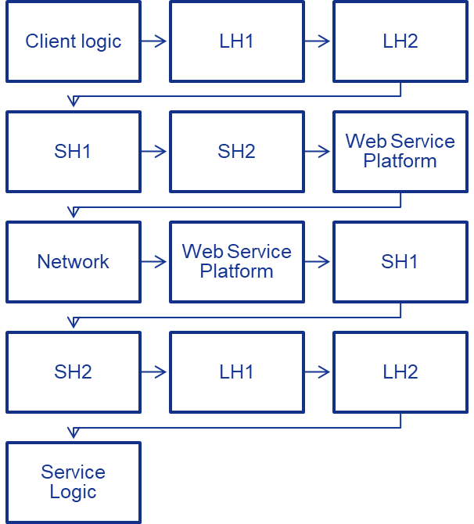
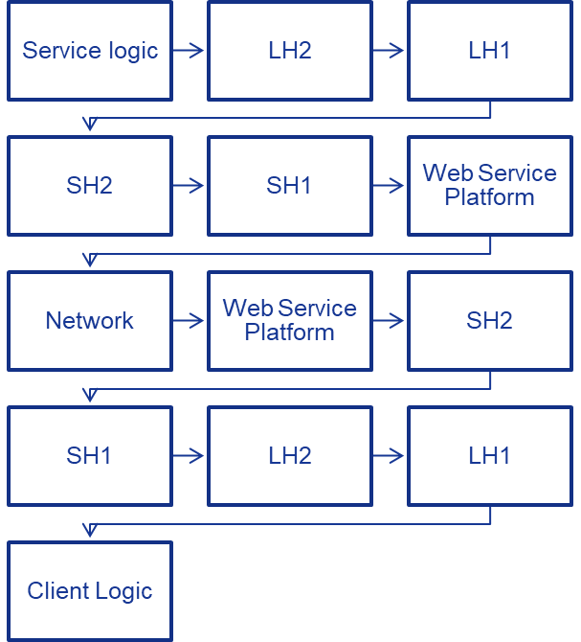
Handlers Overviews
We have the same handler chain on server and client : LH1/SH1/LH2/SH2 (LH=LogicalHandler, SH=SOAPHandler)
The invoke process should be:
Request
Response

